Slide 1
Computer Organization and Architecture (AT70.01)
Comp. Sc. and Inf. Mgmt.
Asian Institute of Technology
Instructor: Dr. Sumanta Guha
Slide Sources: Based on CA: aQA by Hennessy/Patterson. Supplemented from various freely downloadable sources

Slide 2
Advanced Topic:
Hardware-Based Speculation
CA:aQA Sec. 3.7

Slide 3
Speculating on Branch Outcomes
To optimally exploit ILP (instruction-level parallelism) – e.g. with pipelining, Tomasulo, etc. – it is critical to efficiently maintain control dependencies (=branch dependencies)
Key idea: Speculate on the outcome of branches(=predict) and execute instructions as if the predictions are correct
  of course, we must proceed in such a manner as to be able to recover if our speculation turns out wrong
Three components of hardware-based speculation
  dynamic branch prediction to pick branch outcome
  speculation to allow instructions to execute before control dependencies are resolved, i.e., before branch outcomes become known – with ability to undo in case of incorrect speculation
  dynamic scheduling

Slide 4
Speculating with Tomasulo
Modern processors such as PowerPC 603/604, MIPS R10000, Intel Pentium II/III/4, Alpha 21264 extend Tomasulo’s approach to support speculation
Key ideas:
  separate execution from completion: allow instructions to execute speculatively but do not let instructions update registers or memory until they are no longer speculative
  therefore, add a final step – after an instruction is no longer speculative – when it is allowed to make register and memory updates, called instruction commit
  allow instructions to execute and complete out of order but force them to commit in order
  add a hardware buffer, called the reorder buffer (ROB), with registers to hold the result of an instruction between completion and commit

Slide 5
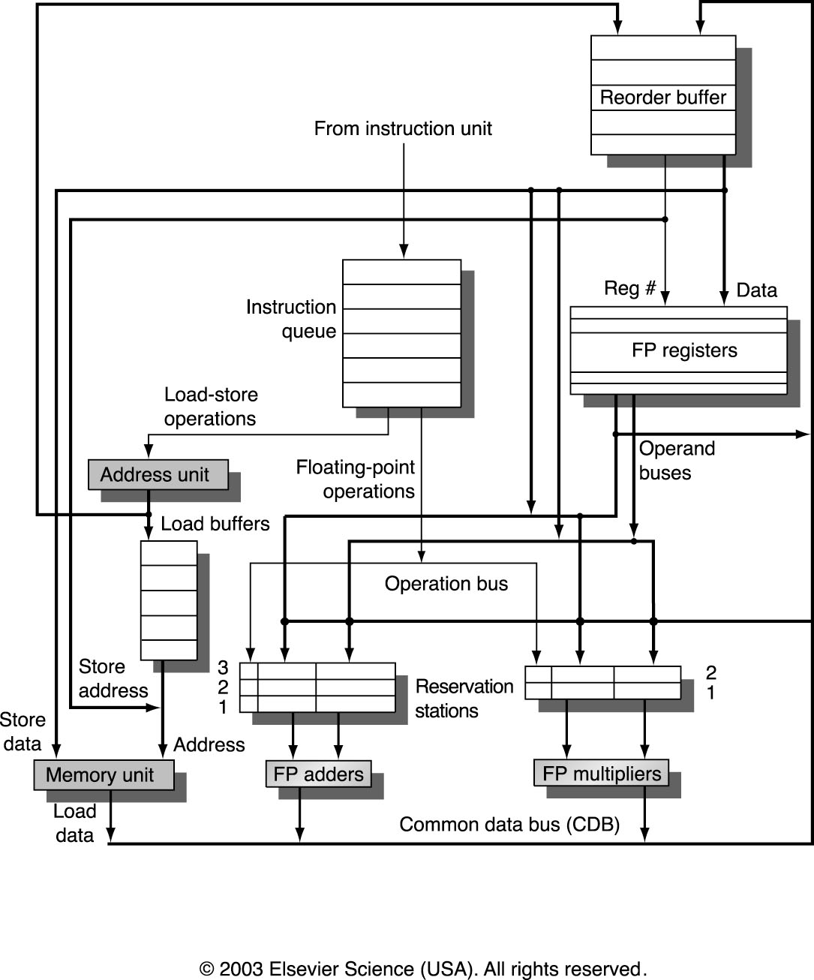
Tomasulo Hardware with Speculation
Basic structure of MIPS floating-point unit based on Tomasulo and extended
to handle speculation: ROB is added and store buffer in original Tomasulo is
eliminated as its functionality is integrated into the ROB
ROB is a queue!

Slide 6
Tomasulo’s Algorithm with Speculation: Four Stages
Issue: get instruction from Instruction Queue
  if reservation station and ROB slot free (no structural hazard),
  control issues instruction to reservation station and ROB, and sends to reservation station operand values (or reservation station source for values) as well as allocated ROB slot number
Execution: operate on operands (EX)
  when both operands ready then execute;
  if not ready, watch CDB for result
Write result: finish execution (WB)
  write on CDB to all awaiting units and ROB;
  mark reservation station available
Commit: update register or memory with ROB result
  when instruction reaches head of ROB and results present, update register with result or store to memory and remove instruction from ROB
  if an incorrectly predicted branch reaches the head of ROB, flush the ROB, and restart at correct successor of branch
Compare Tomasulo’s Algorithm:
Red text = differences!

Slide 7
ROB Data Structure
ROB entry fields
Instruction type: branch, store, register operation (i.e., ALU or load)
State: indicates if instruction has completed and value is ready
Destination: where result is to be written – register number for register operation (i.e. ALU or load), memory address for store
  branch has no destination result
Value: holds the value of instruction result till time to commit
Additional reservation station field
Destination: Corresponding ROB entry number

Slide 8
Example
L.D F6, 34(R2)
L.D F2, 45(R3)
MUL.D F0, F2, F4
SUB.D F8, F2, F6
DIV.D F10, F0, F6
ADD.D F6, F8, F2
Assume latencies load 1 clock, add 2 clocks, multiply 10 clocks, divide 40 clocks
Show data structures just before MUL.D goes to commit…

Slide 9
Reservation Stations
Name Busy Op Vj Vk Qj Qk Dest A
Load1 no
Load2 no
Add1 no
Add2 no
Add3 no
Mult1 yes MUL Mem[45+Regs[R3]] Regs[F4] #3
Mult2 yes DIV Mem[34+Regs[R2]] #3 #5
Addi indicates ith reservation station for the FP add unit, etc.

Slide 10
Reorder Buffer
Entry Busy Instruction State Destination Value
1 no L.D F6, 34(R2) Commit F6 Mem[34+Regs[R2]]
2 no L.D F2, 45(R3) Commit F2 Mem[45+Regs[R3]]
3 yes MUL.D F0, F2, F4 Write result F0 #2 × Regs[F4]
4 yes SUB.D F8, F6, F2 Write result F8 #1 – #2
5 yes DIV.D F10, F0, F6 Execute F10
6 yes ADD.D F6, F8, F2 Write result F6 #4 + #2
At the time MUL.D is ready to commit only the two L.D instructions have
already committed, though others have completed execution
Actually, the MUL.D is at the head of the ROB – the L.D instructions are
shown only for understanding purposes
#X represents value field of ROB entry number X

Slide 11
Registers
Field F0 F1 F2 F3 F4 F5 F6 F7 F8 F10
Reorder# 3 6 4 5
Busy yes no no no no no yes … yes yes
Floating point registers

Slide 12
Example
Loop: LD F0 0 R1
MULTD F4 F0 F2
SD F4 0 R1
SUBI R1 R1 #8
BNEZ R1 Loop
Assume instructions in the loop have been issued twice
Assume L.D and MUL.D from the first iteration have committed and all other instructions have completed
Assume effective address for store is computed prior to its issue
Show data structures…

Slide 13
Reorder Buffer
Entry Busy Instruction State Destination Value
1 no L.D F0, 0(R1) Commit F0 Mem[0+Regs[R1]]
2 no MUL.D F4, F0, F2 Commit F4 #1 × Regs[F2]
3 yes S.D F4, 0(R1) Write result 0 + Regs[R1] #2
4 yes DADDUI R1, R1, #-8 Write result R1 Regs[R1] – 8
5 yes BNE R1, R2, Loop Write result
6 yes L.D F0, 0(R1) Write result F0 Mem[#4]
7 yes MUL.D F4, F0, F2 Write result F4 #6 × Regs[F2]
8 yes S.D F4, 0(R1) Write result 0 + #4 #7
9 yes DADDUI R1, R1, #-8 Write result R1 #4 – 8
10 yes BNE R1, R2, Loop Write result

Slide 14
Registers
Field F0 F1 F2 F3 F4 F5 F6 F7 F8
Reorder# 6 7
Busy yes no no no yes no no … no

Slide 15
Notes
If a branch is mispredicted, recovery is done by flushing the ROB of all entries that appear after the mispredicted branch
  entries before the branch are allowed to continue
  restart the fetch at the correct branch successor
When an instruction commits or is flushed from the ROB then the corresponding slots become available for subsequent instructions

